Slide 1
Coding Challenge
Timed
Interview

Slide 2
Contents
This is a coding interview with four questions. We are looking for code that is clean, readable, performant, and maintainable. There are four rounds - four questions and you have 10 minutes to complete each question. Then you have 30 seconds to copy your code into the link that you will receive in your chat section and submit it. Each question is in the form of a google form where your submission will be made. There will be a reminder when a minute is left for each round. Please make sure to submit your code into the long-answer text.
The languages you are being tested on are as follows :
JavaScript
C++
Python
Solidity

Slide 3
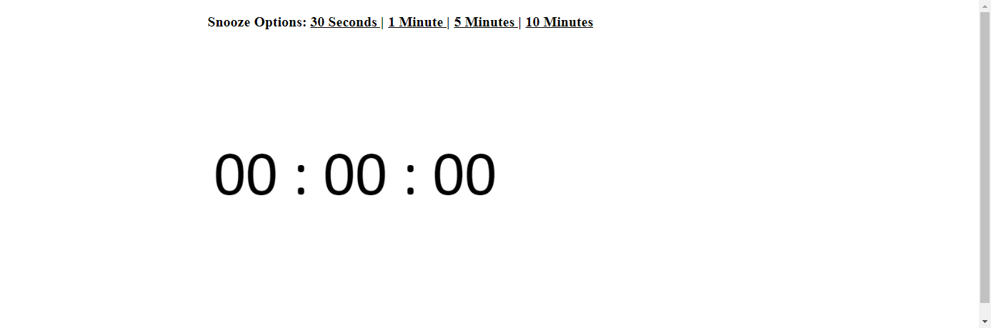
JavaScript
1. Write a JavaScript function that does the following :
Console logs the number from 1 to n, where n is the integer, the function takes as its parameter
Logs “triz” instead of the number for multiples of 3
Logs “penta” instead of the number for multiples of 5
Logs “tripenta” for numbers that are multiples of both 3 and 5

Slide 4
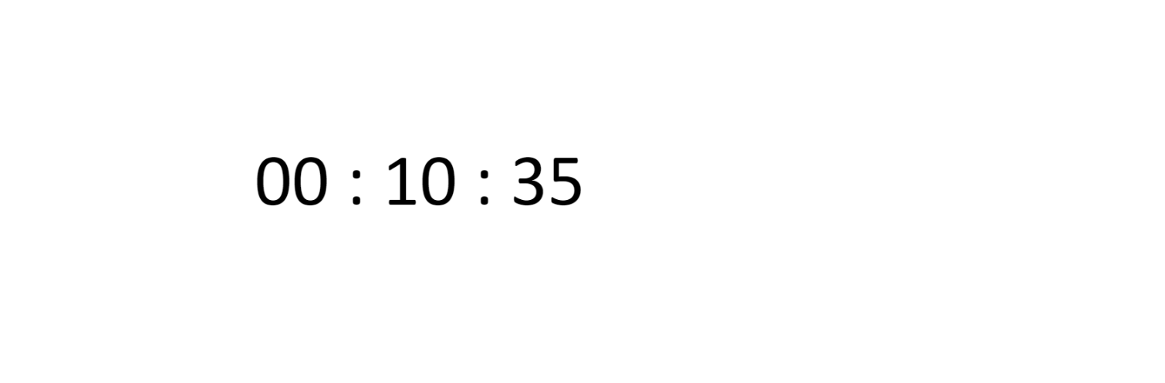
C++
2. Write a simple code snippet that has a function to control movement of an object using the arrow keys.

Slide 5
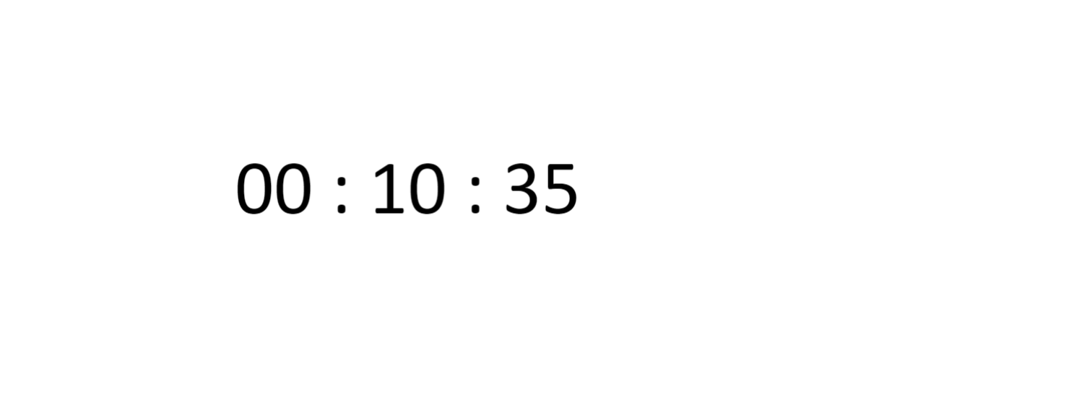
Python
3. Write a program that accepts a comma separated sequence of words as input and prints the words in a comma-separated sequence after sorting them alphabetically.
For example -
If input is - “bag, hello, apple, world, war
Then output should be - “apple, bag, hello, war, world”

Slide 6
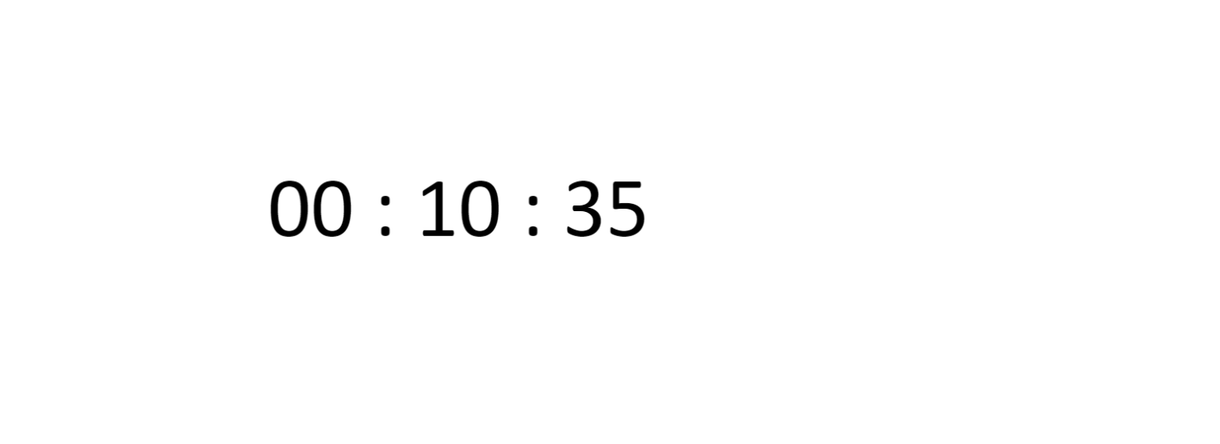
Solidity
4. Write a simple smart contract in solidity, that will allow us to store an unsigned integer and retrieve it. You can use Remix IDE to deploy your contract on any of the test networks like Ropsten/Rinkeby.

Slide 7

Thank You
Have A Good Day!

